Slide 1
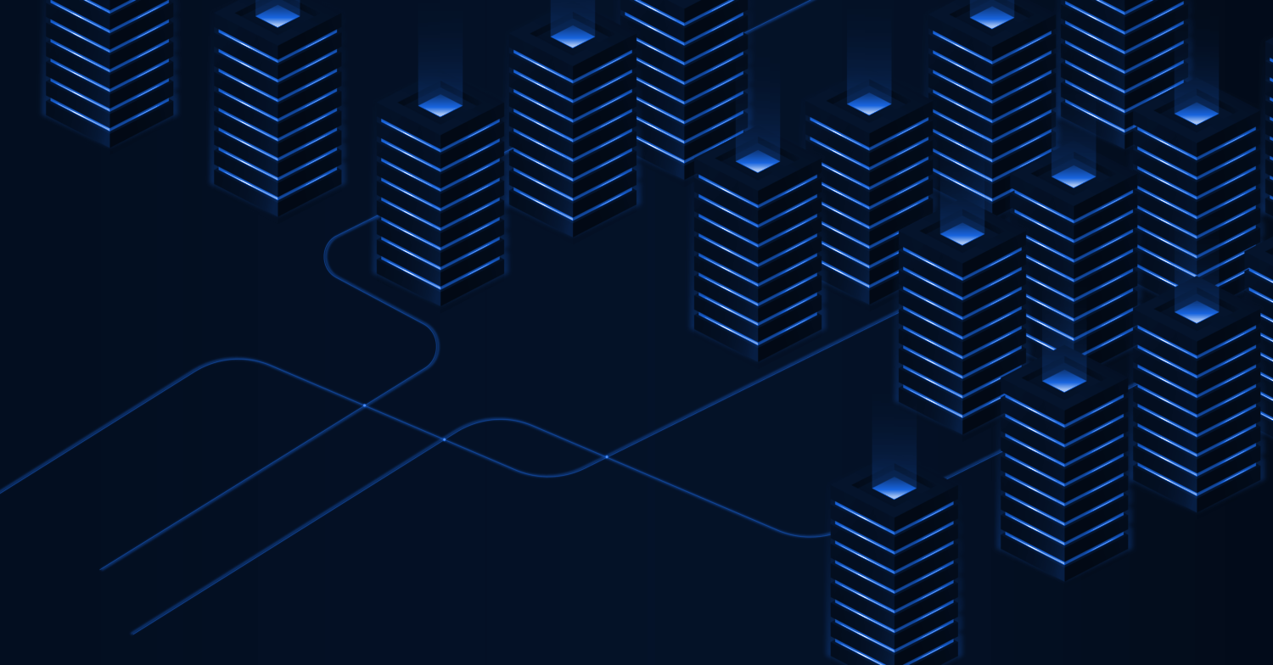
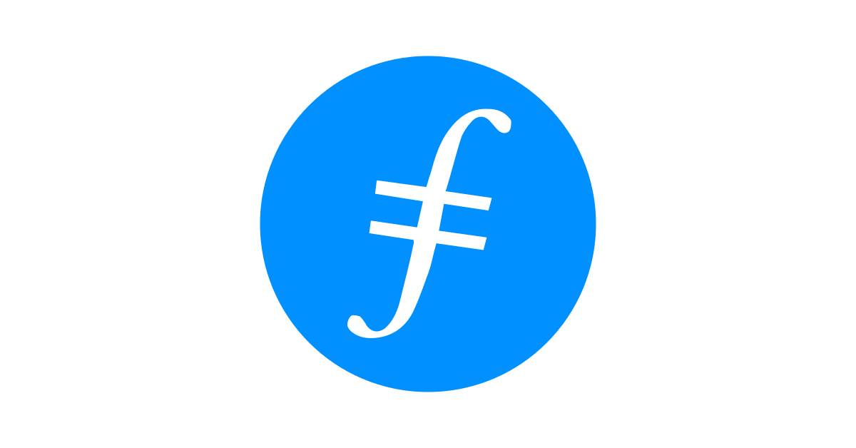
Introduction to IPFS & Filecoin

Slide 2
What today’s session is:
IPFS & Filecoin
Core concepts of Filecoin
Web3 possibilities
What it isn’t:
Deep dives into cryptography or economics
Hands-on tutorials (but…)

Slide 3









Web3-Enabled Architectures
...with decentralized possibilities at every layer
Frontend
Web2
Web apps · Data solutions
Web3
NFTs · Dapps · more
Logic Standard application logic or smart contracts
Storage Helpers Simplify storing & retrieving data (SDKs, hosted APIs, and more)
Filecoin & IPFS Storage

Slide 4
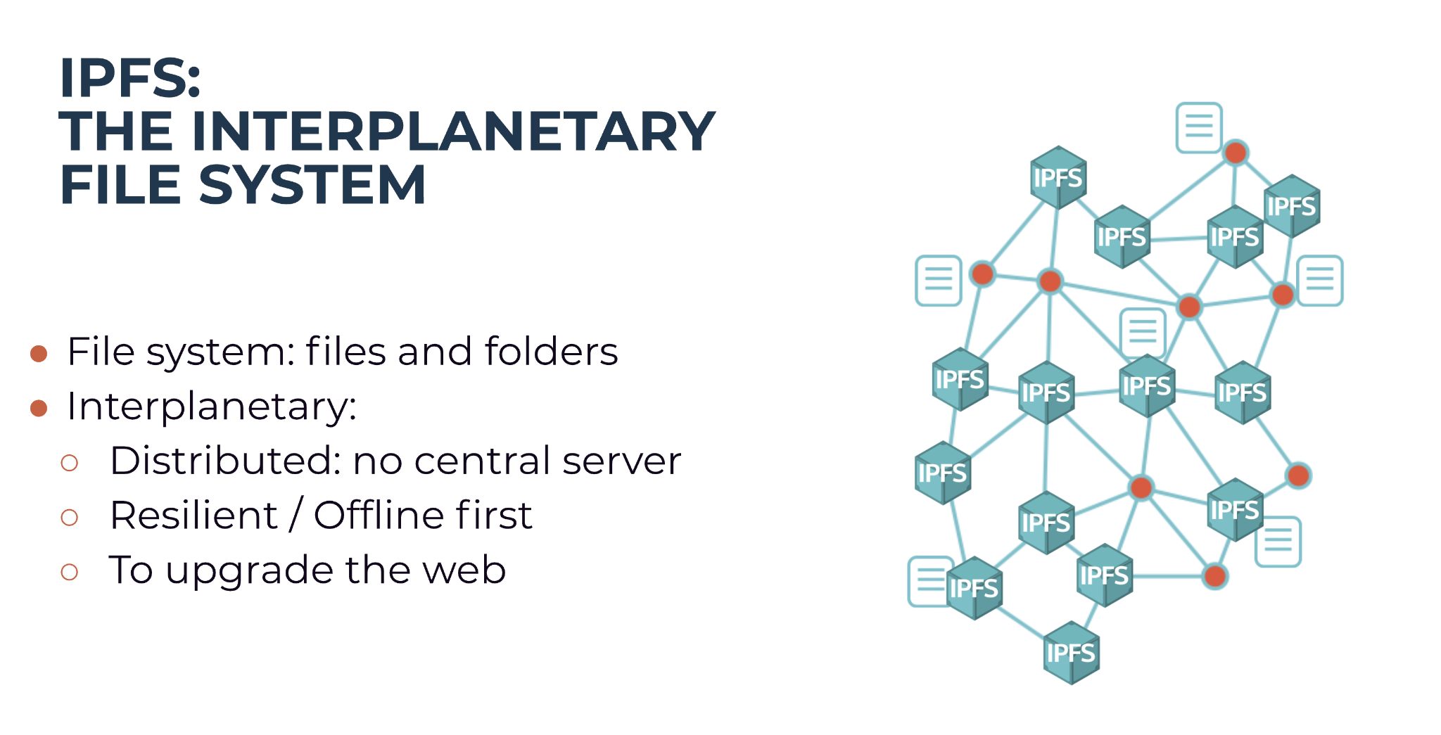

Slide 5
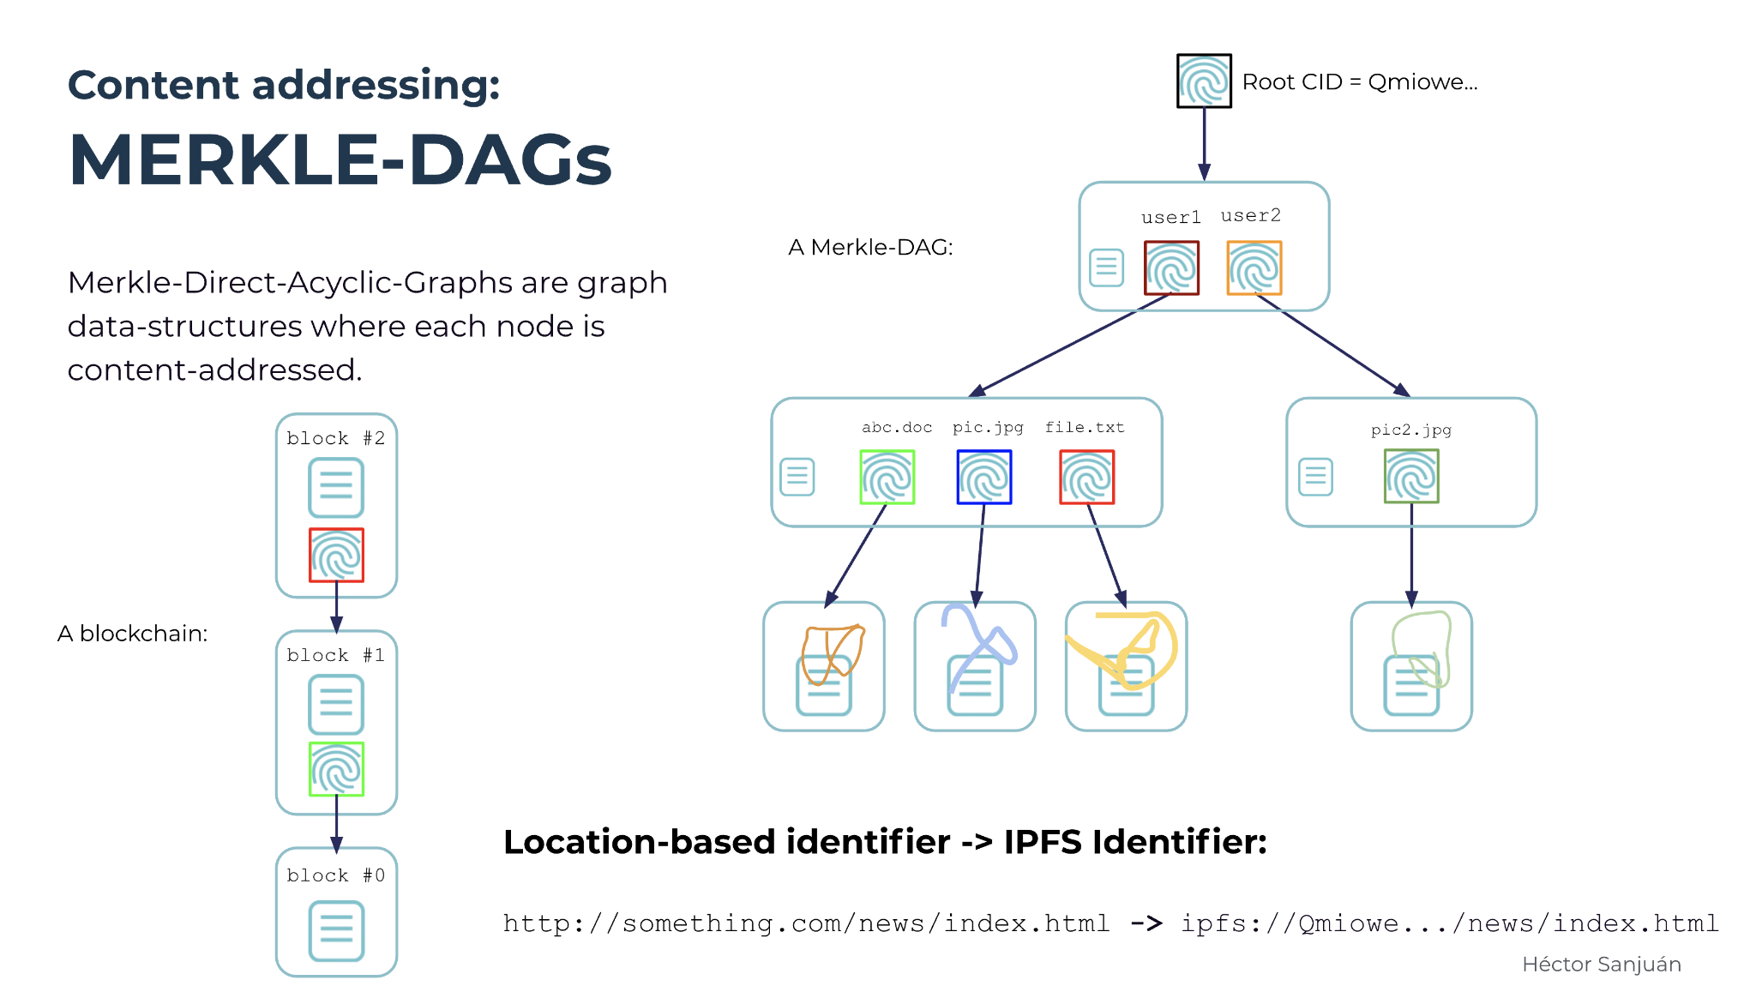

Slide 6
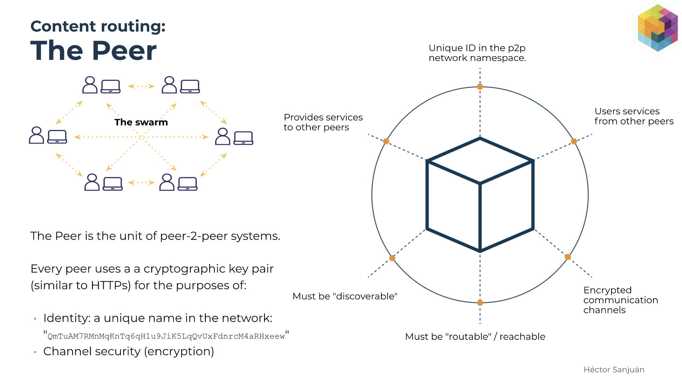

Slide 7
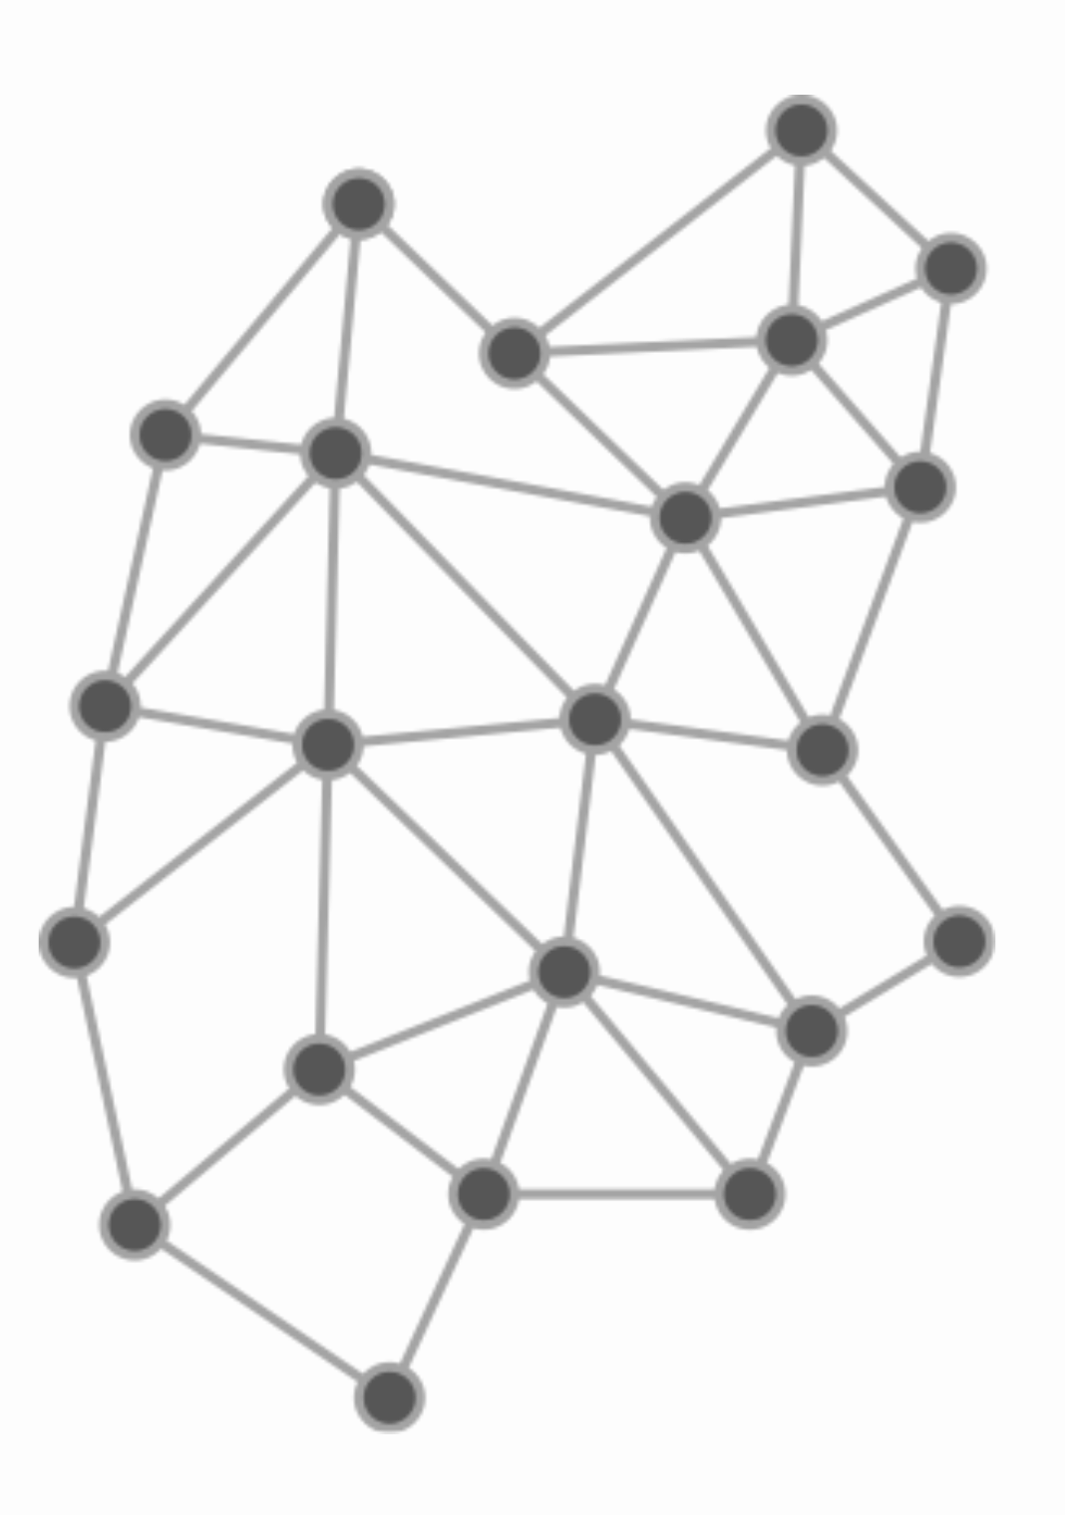

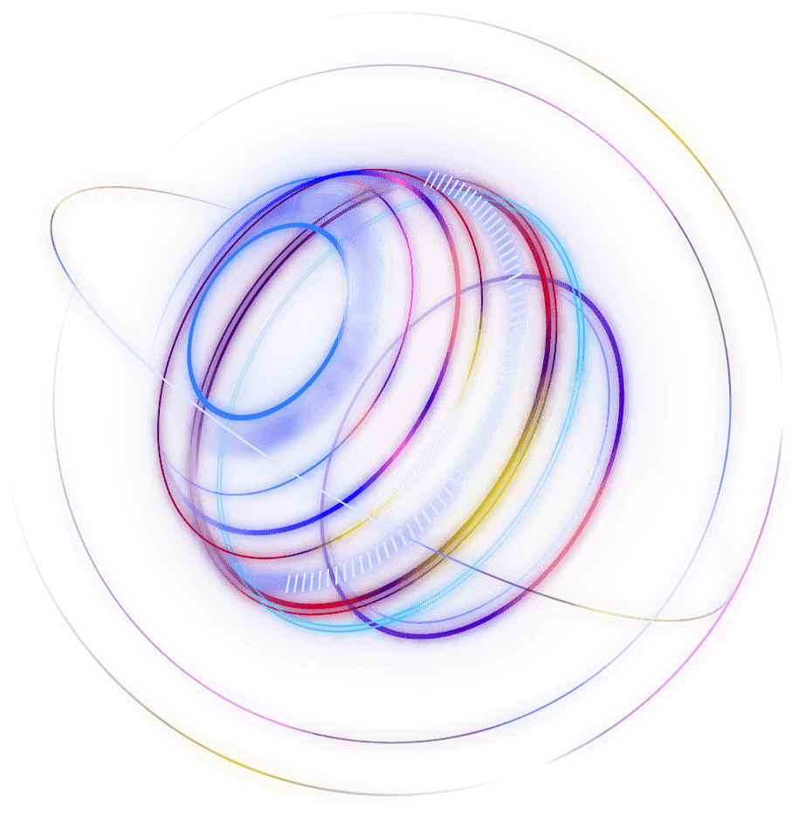


Using IPFS in the wild Who runs p2p nodes, and why?
You can run your own node.
You can hope your content becomes popular enough that other nodes will probably pin it.
You can run your own network of nodes. (and an infrastructure team to manage it)
You can pay a pinning service to pin your content on their nodes. (Pinata, Temporal, Infura, and more)

Slide 8
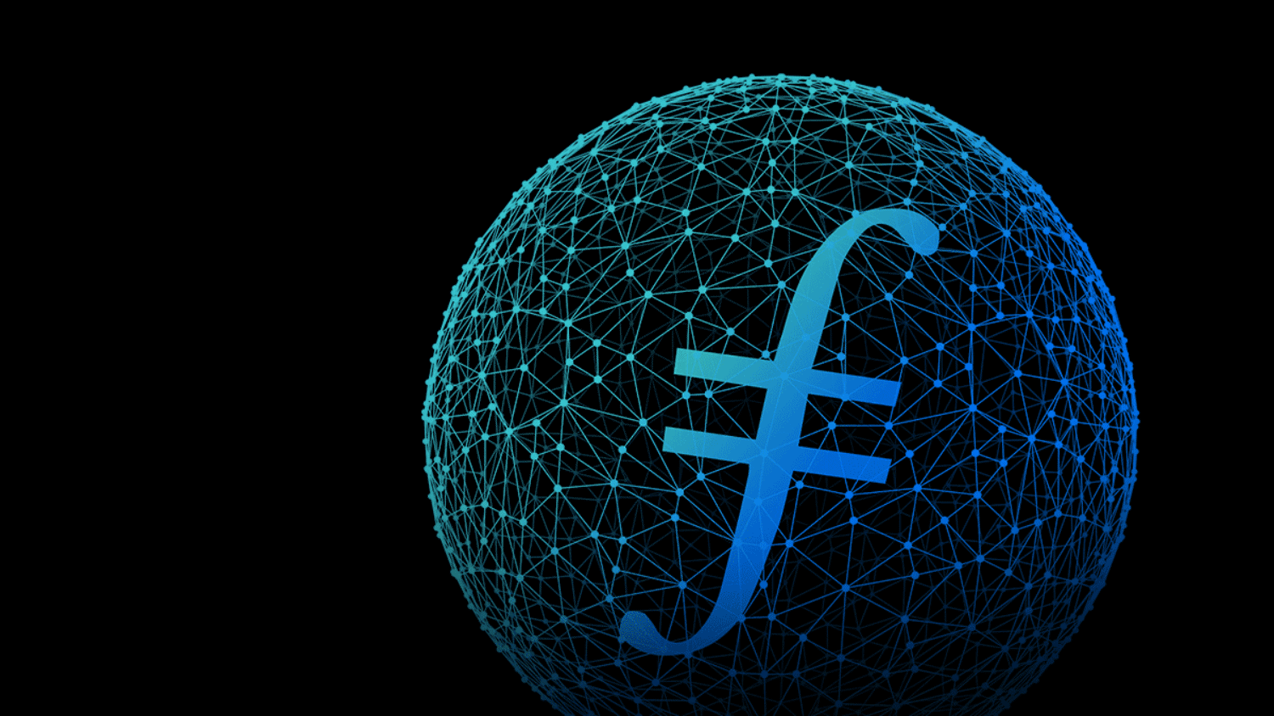
What about alternatives that are decentralized and reliable?

Slide 9
Filecoin is storage designed for Web3 from the ground up
Compatible with IPFS & Web3
Verifiable, via cryptographic proofs
A massive, decentralized network
Use IPFS as a building block to share all the benefits of content addressing and CIDs. Integrate with Web3 networks like NEAR, Chainlink, Hedera, & more.
How can you prove that you’re really storing my data and keeping your promises? How can I enforce this in a decentralized network?
8 exabytes across the globe from hundreds of storage providers. Governed by consensus, instead of any single corporation.

Slide 10
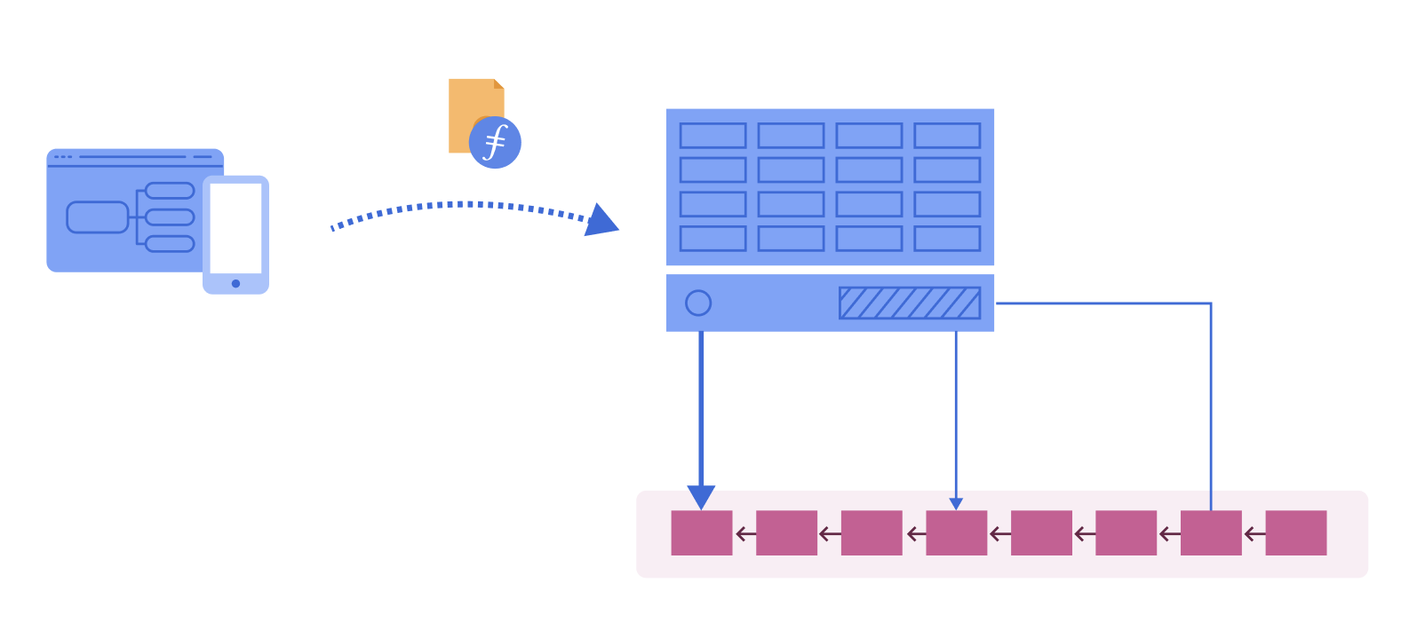
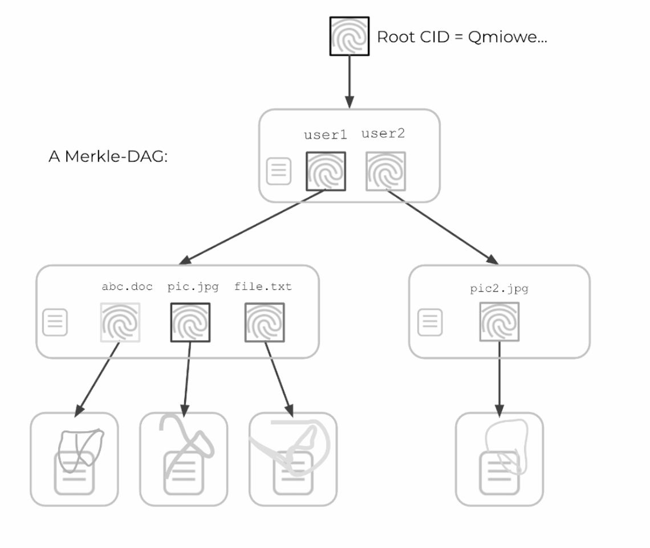
CORE CONCEPTS
Verifiable Storage on Filecoin
1
You (or your app) make a deal with a provider to store your data.
Filecoin preps your data by transforming it into a Directed Acyclic Graph (DAG). It uses the same process as IPFS, so the resulting CIDs are compatible.
2
Providers generate an initial Proof of Replication (PoRep). That’s part of the storage deal that they publish to the Filecoin blockchain.
4
Get your data by making retrieval deals with providers.
You can also check the chain for proof that it’s being stored (and stored correctly) at any time.
3
Over time, providers have to keep proving that they still have subsets of your data, creating Proofs of SpaceTime (PoST). They are paid incrementally for keeping up the storage deal.

Slide 11
CORE CONCEPTS
IPFS ❤️ Filecoin
IPFS for fast, flexible retrieval (gateways, local nodes, browsers, oh my!).
Filecoin for persistence and verifiability.

Slide 12
Filecoin is both a Protocol & Network
Most builders will take advantage of the ecosystem of libraries, tools, & services to build great apps. Let’s take a peek!
Users
Apps
Services (hosted APIs, etc.)
Tools & Libraries
Core Protocol Implementation (lotus, forest, venus, etc.)

Slide 13
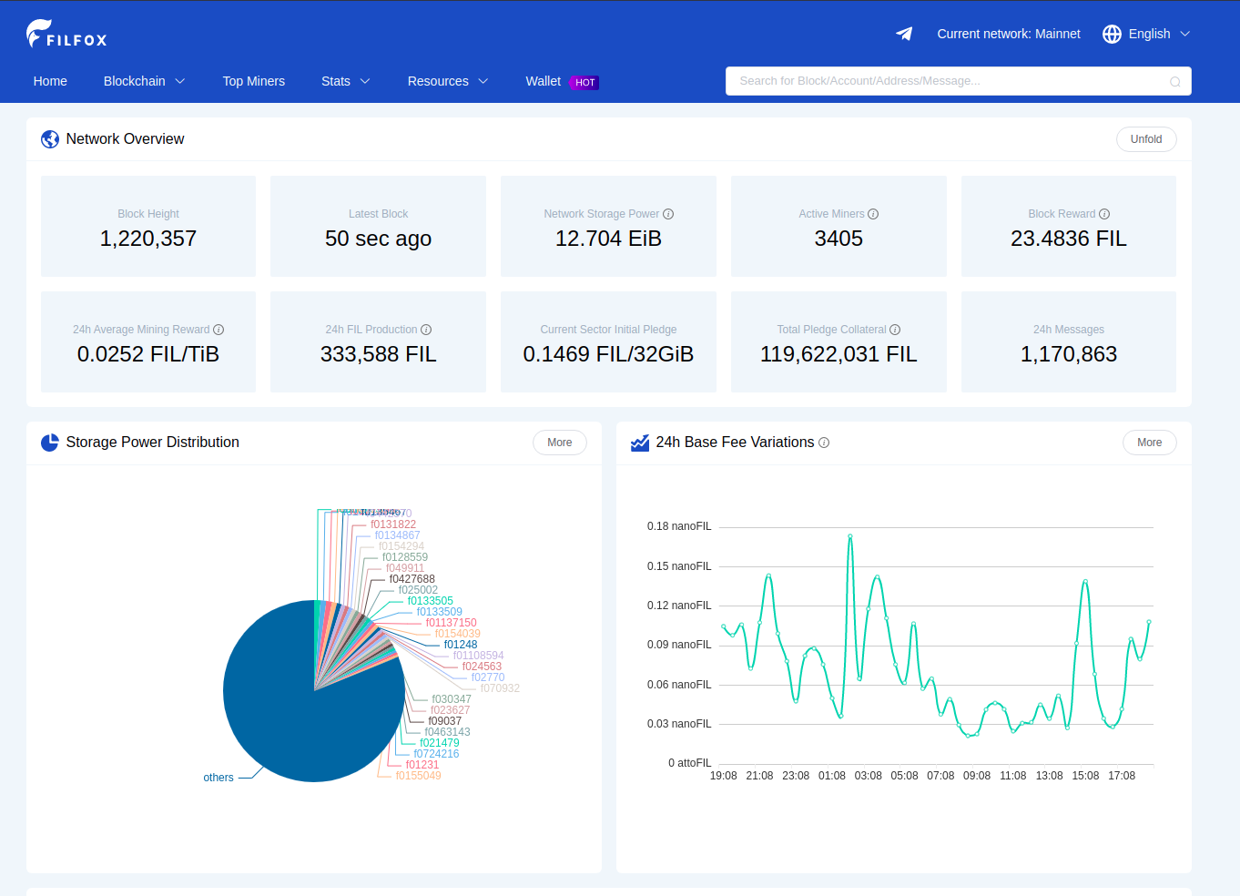

Slide 14

What can I build with Filecoin?

Slide 15
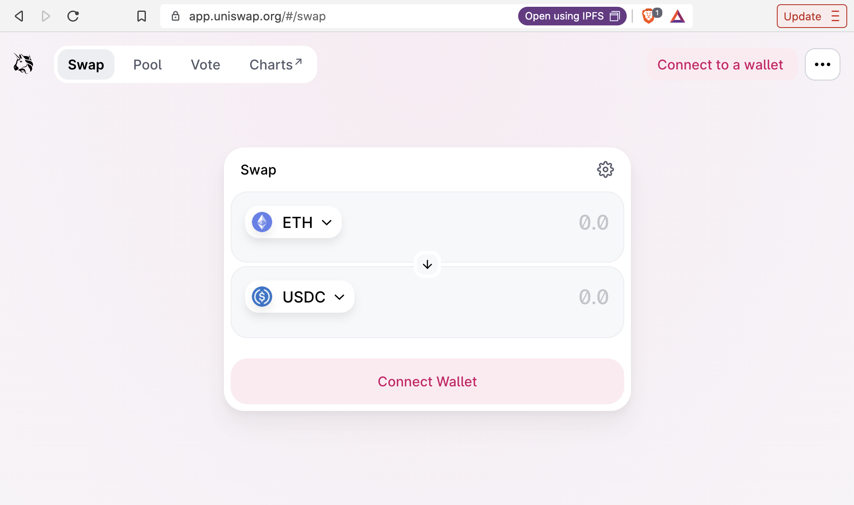
Using hosted service:
(will make deals for you)
Powergate
Estuary
NFT.storage
Space SDK
Space Daemon
Web3 all the way down
Ask your dweb-enabled browser for a CID
Frontend loads from IPFS
Chrome w/ IPFS Companion, or Brave Browser
ipfs://Qw134...h6c
Login with a DWeb wallet
Or your regular browser, via a gateway
Storage helper
Content stored on IPFS or Filecoin

Slide 16
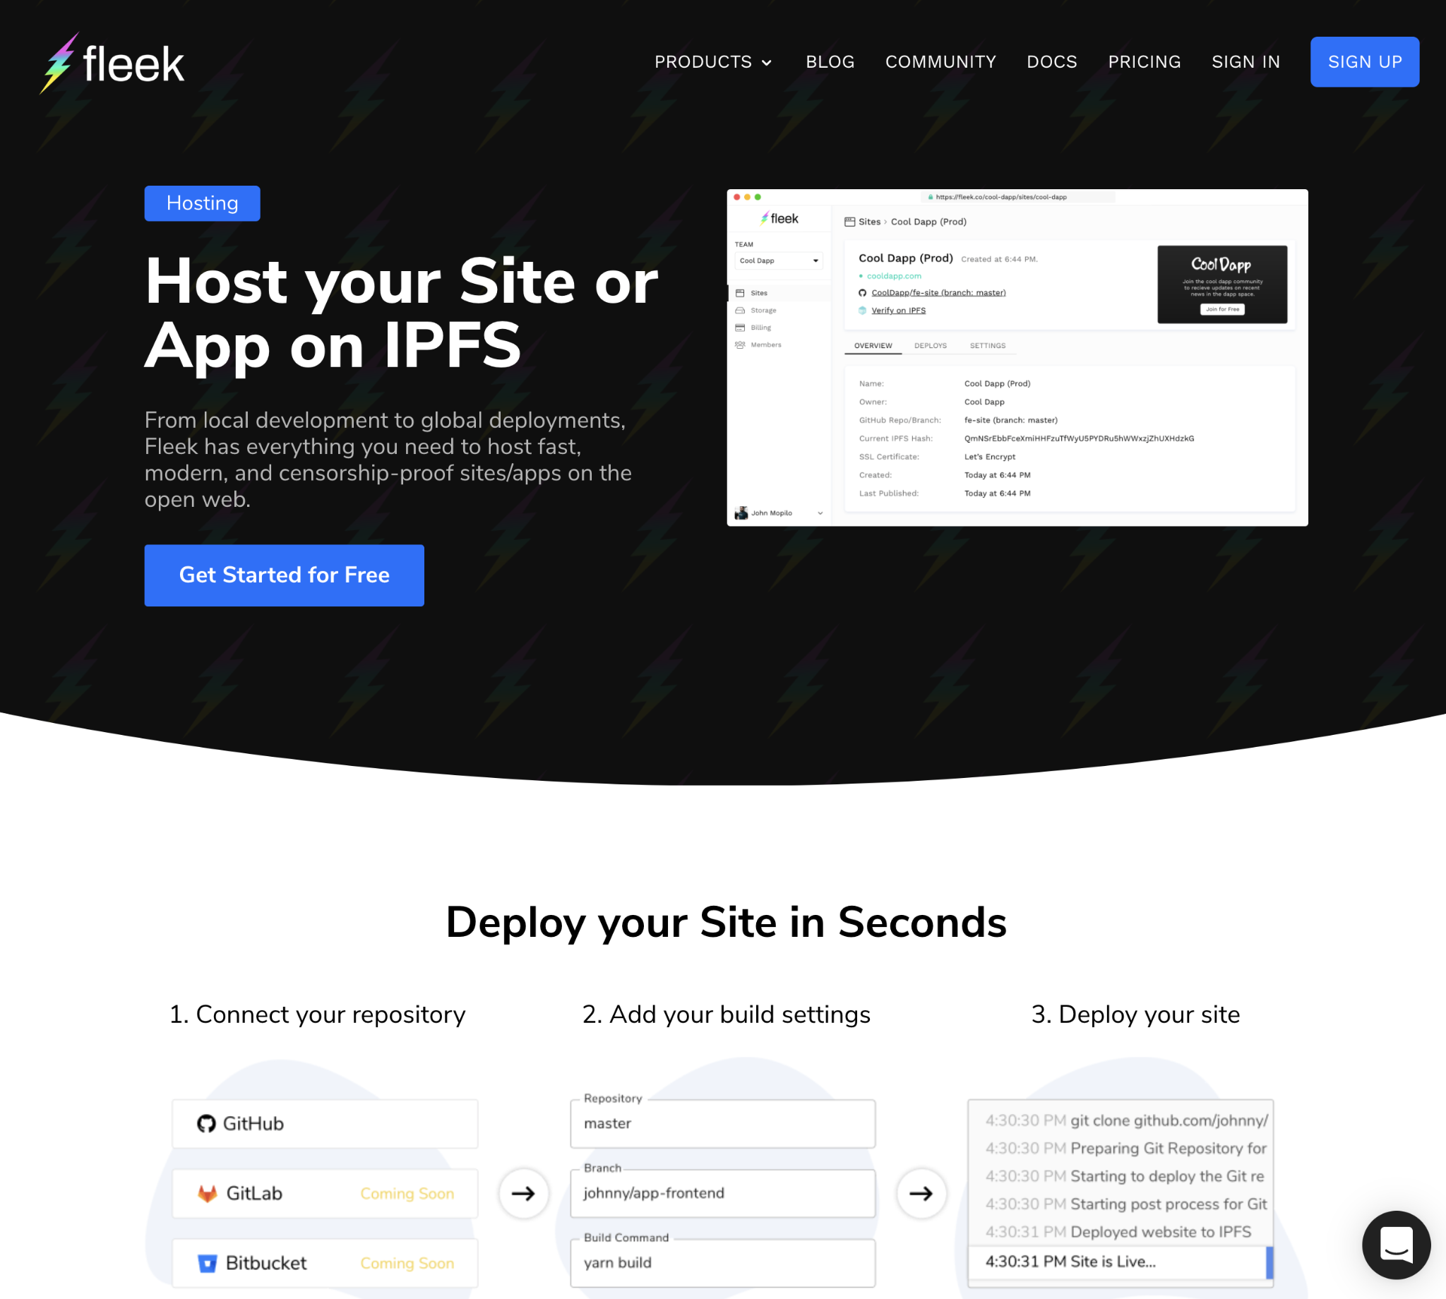
STORING DATA
Fleek IPFS Hosting fleek.co/hosting
DESIGNED FOR
Fast, modern, censorship-proof websites and webapps on the open web
Works with most modern frameworks (Docker, Gatsby, React, Webflow, Hugo, Next, Jekyll, etc.)
HOW IT WORKS
Connect your Github repository
Add build settings
Deploy your site to IPFS
Backed up to Filecoin
USAGE
Github Actions
CLI
GraphQL API

Slide 17
Storage Helpers for DApps

Slide 18
Using hosted service:
(will make deals for you)
Powergate
Estuary
NFT.storage
Space SDK
Space Daemon
Storing & Retrieving Data
We highly recommend choosing a storage helper. They simplify deals and workflows, making it fast and easy to build.
Simplify dealmaking. Finding providers, negotiating prices, waiting for confirmations, verifying storage — storage helpers handle it all for you.
Store to both IPFS and Filecoin with a single call. IPFS for fast, flexible retrieval (gateways, local nodes, browsers, oh my!). Filecoin for persistence and verifiability.

Slide 19
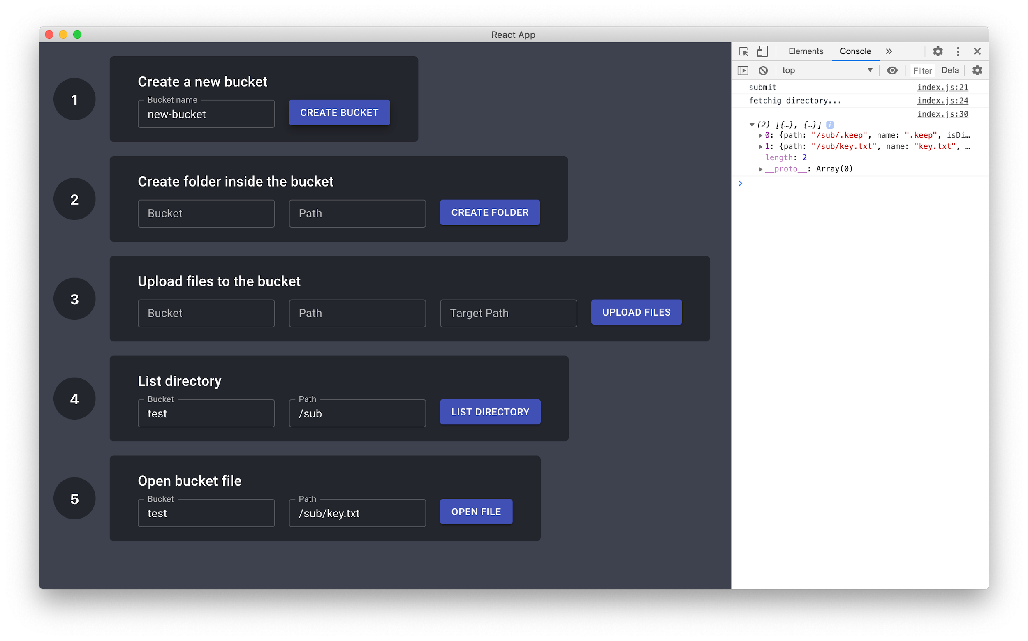
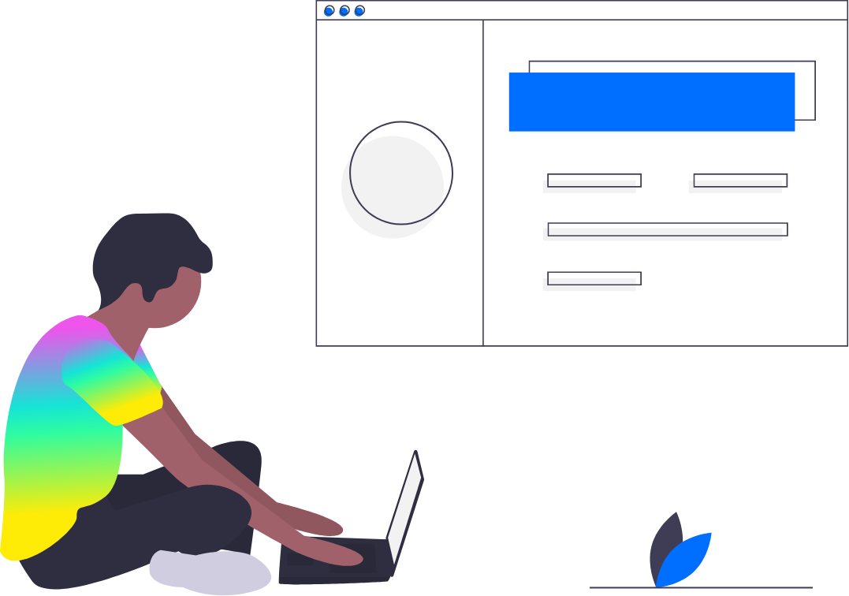
STORING DATA
Fleek Space Daemon docs.fleek.co/space-daemon
DESIGNED FOR
Ideal for building desktop apps
Not ideal for web apps
HOW IT WORKS
Combines IPFS, Textile Buckets, & Textile Powergate into one background service
Runs on users’ desktops
Can be bundled with desktop apps
USAGE
gPRC API
JS client
Notes:
Comment from Mosh:
Recommend using hosted service first since it will be easier for developers especially for 2-3 days hachathon

Slide 20
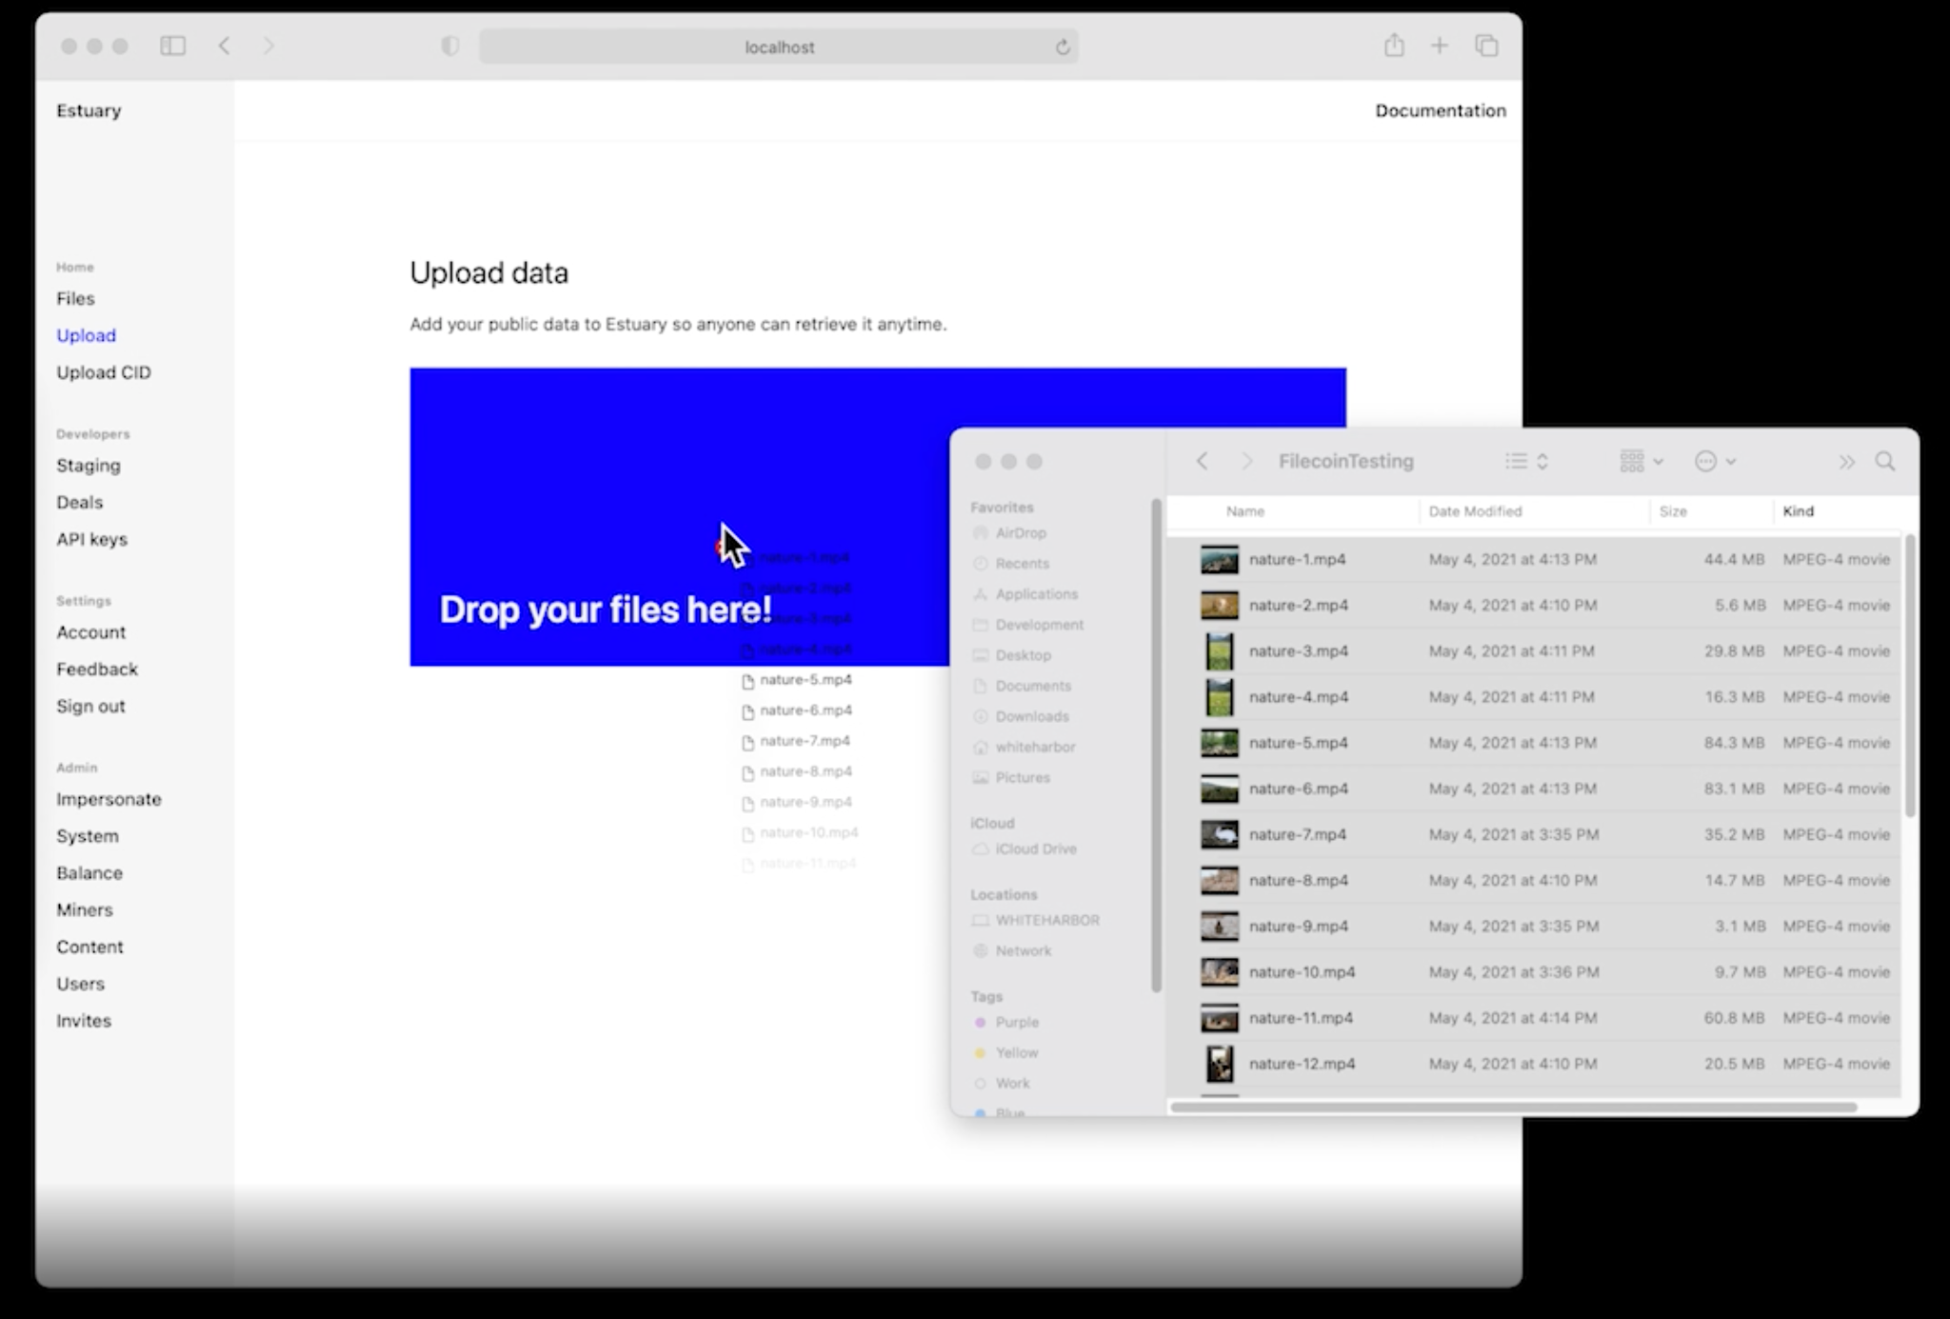
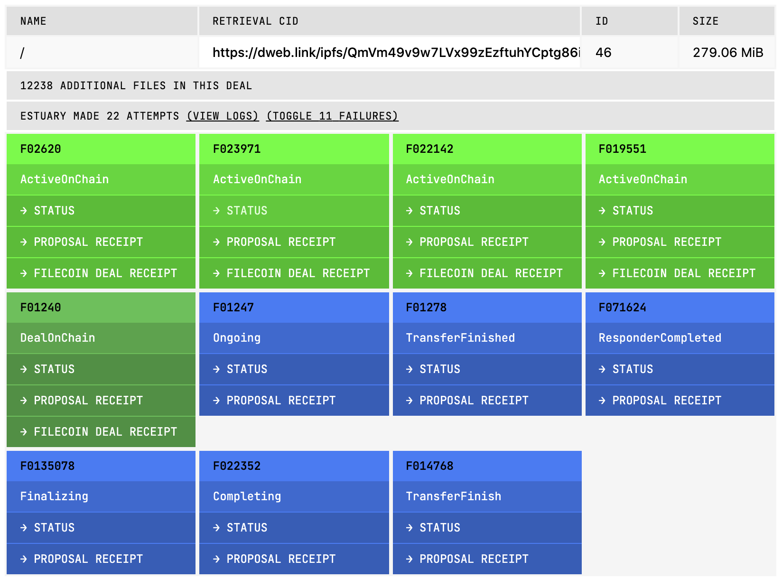
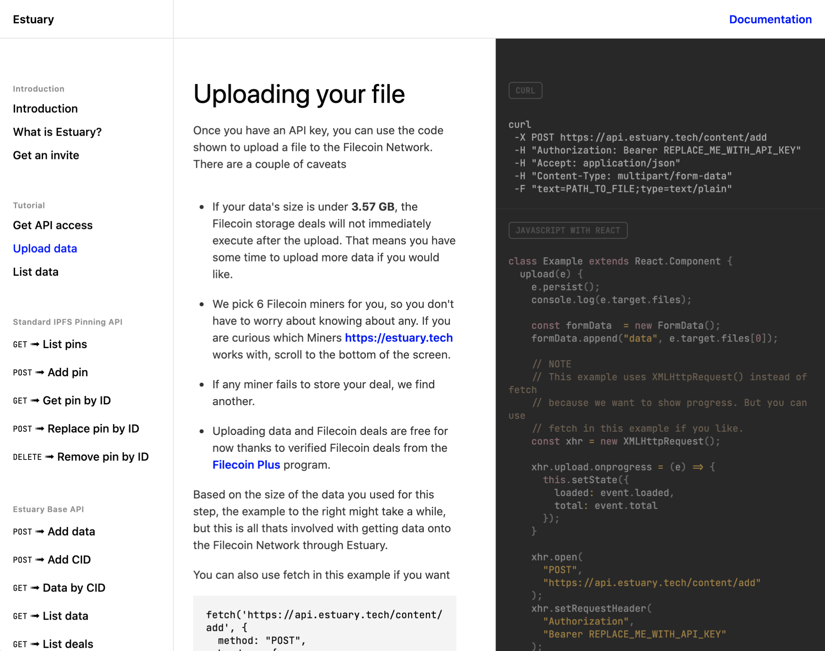
STORING DATA
Estuary docs.estuary.tech
DESIGNED FOR
General Filecoin & IPFS storage
Seamless dealmaking and verification
HOW IT WORKS
Data is immediately uploaded to a hosted Estuary (IPFS+Filecoin) node
Automatically stores with 6 providers around the world
USAGE
HTTP API
CURL
Web interface

Slide 21
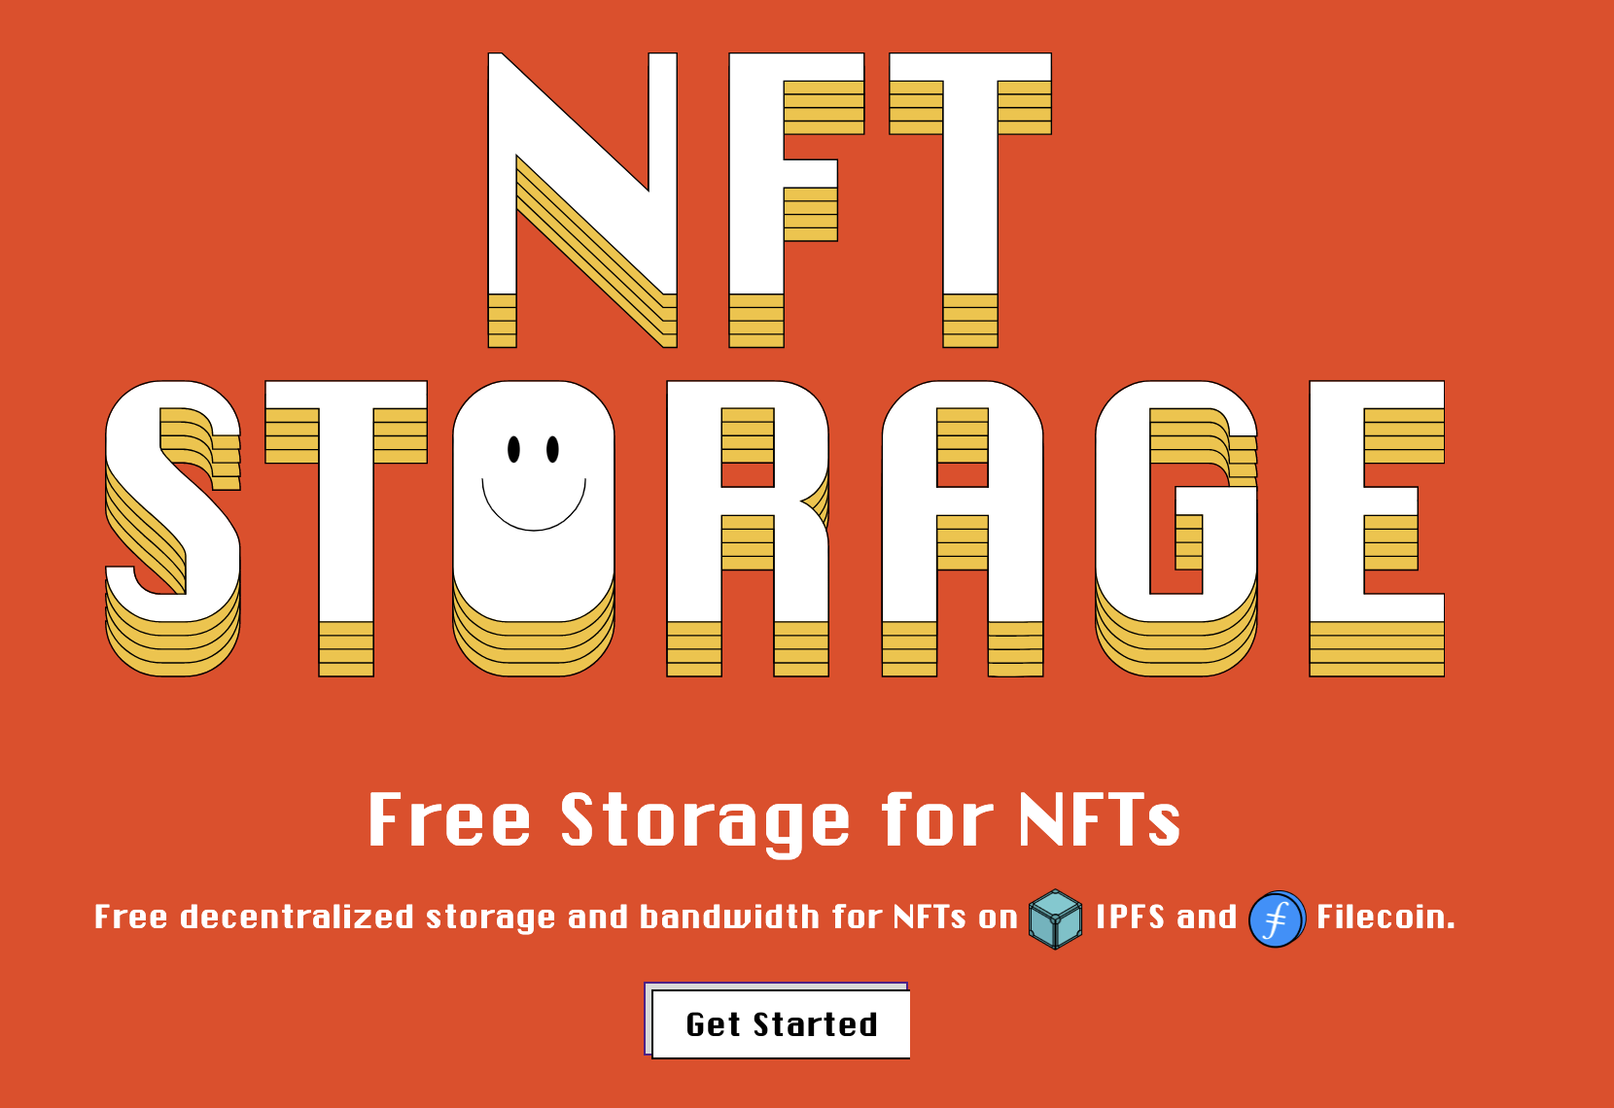
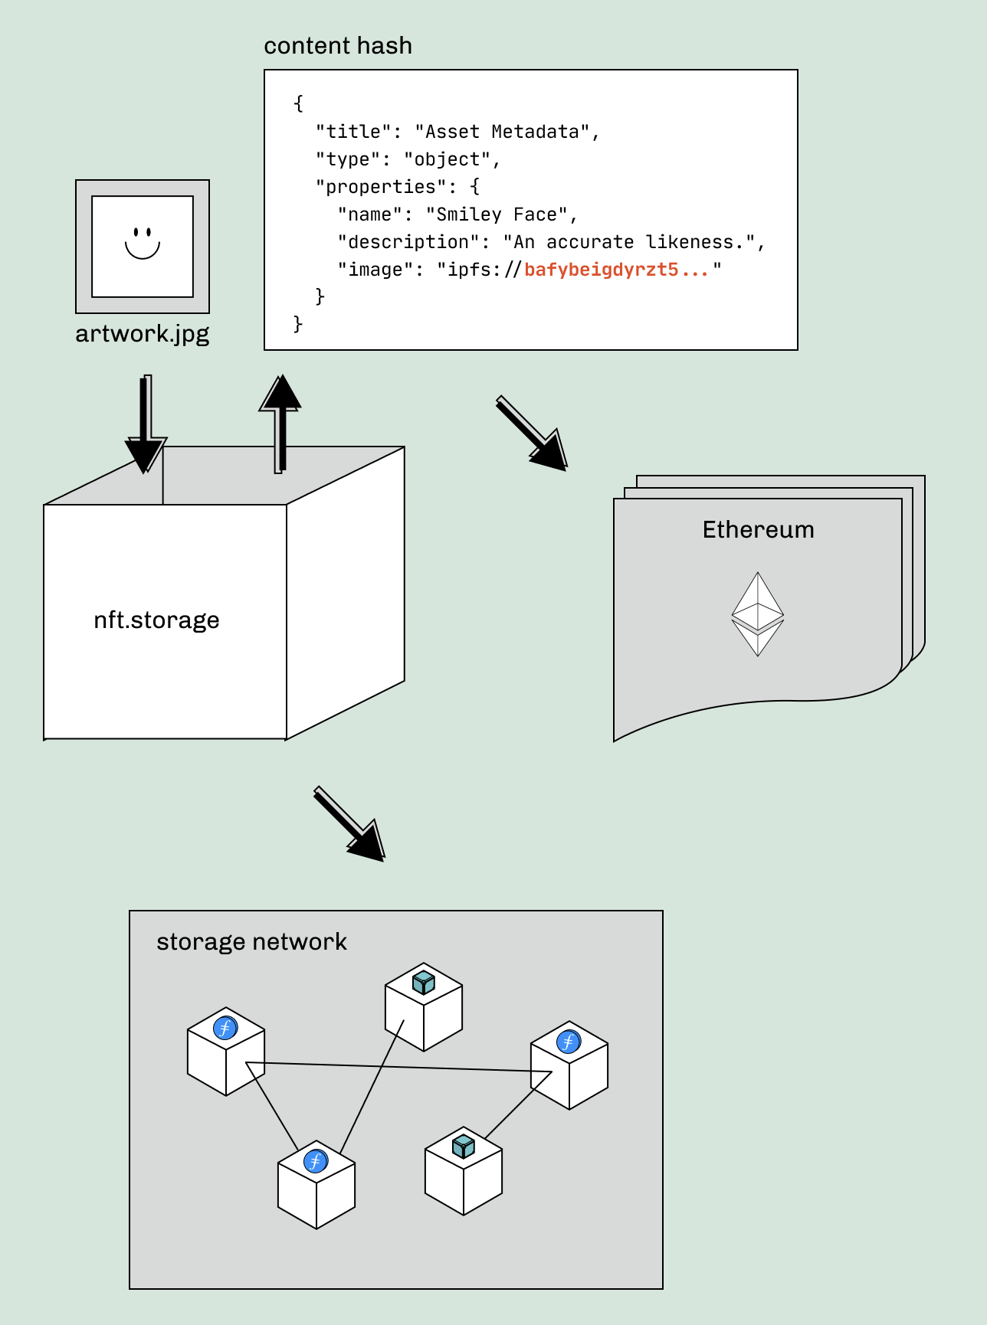
STORING DATA
NFT.Storage nft.storage
DESIGNED FOR
NFT developers who want free decentralized storage
HOW IT WORKS
Upload your data, get back an IPFS hash of the content (a CID) that can be used in on-chain NFT data as a pointer.
Storage + Retrieval is free!
Get properly formatted metadata back!
Fetch it back via IPFS (pinned redundantly >3x)
Backed up to Filecoin (stored redundantly >5x)
USAGE
JS client library
HTTP API
Configured as remote pinning service in IPFS

Slide 22
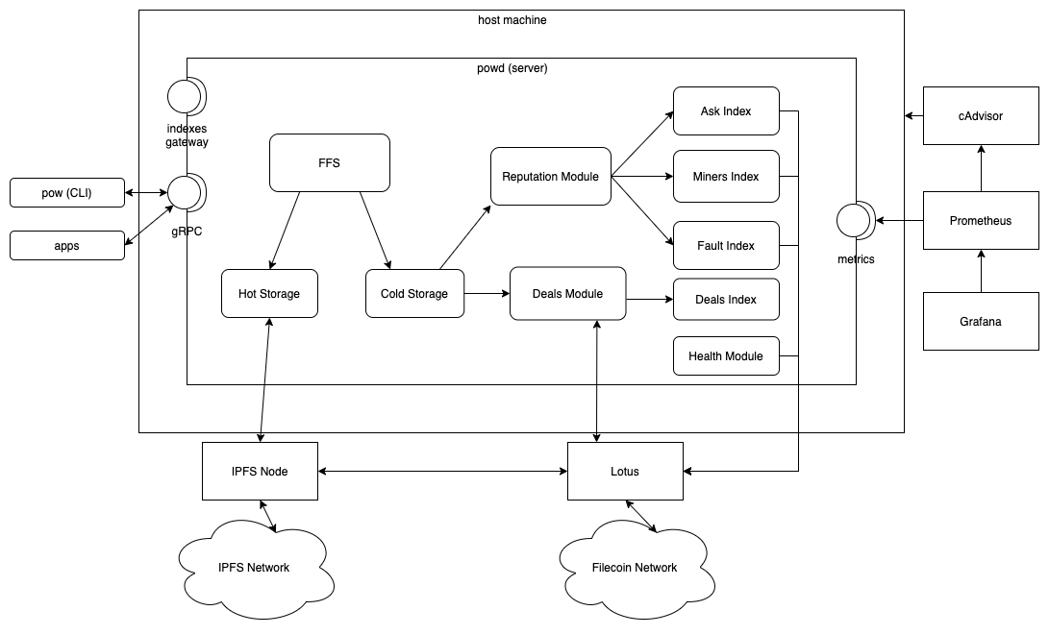
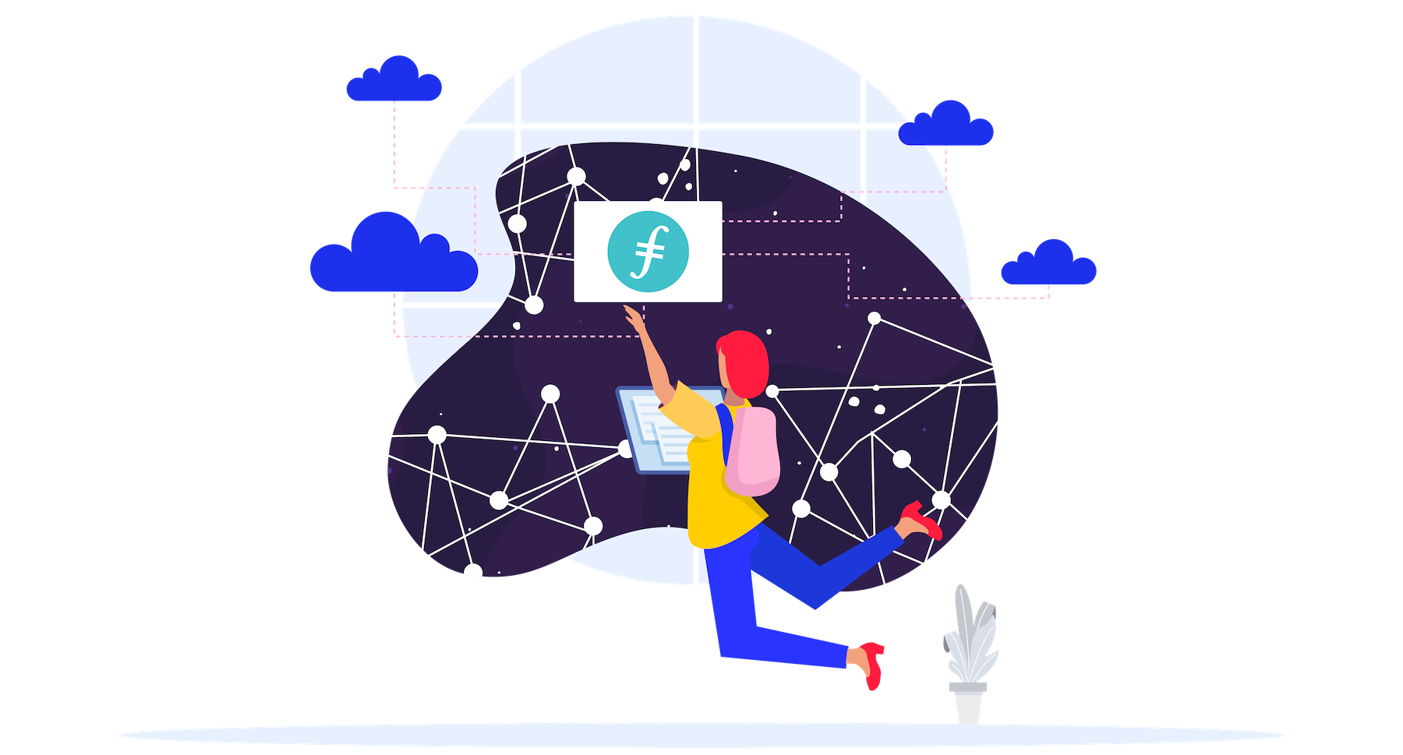
STORING DATA
Powergate docs.textile.io/powergate
DESIGNED FOR
Developers who want powerful ways to connect & extend Libp2p, IPFS, and Filecoin
Bridges to NEAR and (coming soon) Eth, Polygon, & others.
HOW IT WORKS
Docker container wrapped around an IPFS node + Filecoin node
Stage, store, and retrieve data
Default configs for miner selection
USAGE
JS & Go Clients
gRPC API
CLI

Slide 23
Web3-Enabled Architectures
...with decentralized possibilities at every layer
Frontend
Web2
Web apps · Data solutions
Web3
NFTs · Dapps · more
Logic Standard application logic or smart contracts
Storage Helpers Simplify storing & retrieving data (SDKs, hosted APIs, and more)
Filecoin & IPFS Nodes

Slide 24
Keep Learning
Getting Started with IPFS & Filecoin - launchpad for building decentralized apps on IPFS & Filecoin
Proto.school - interactive concepts tutorials
NFT.school - NFT-specific tutorials & demos
Hackathons.filecoin.io - dozens of virtual events for learning, mentorship, building, and competition

Slide 25
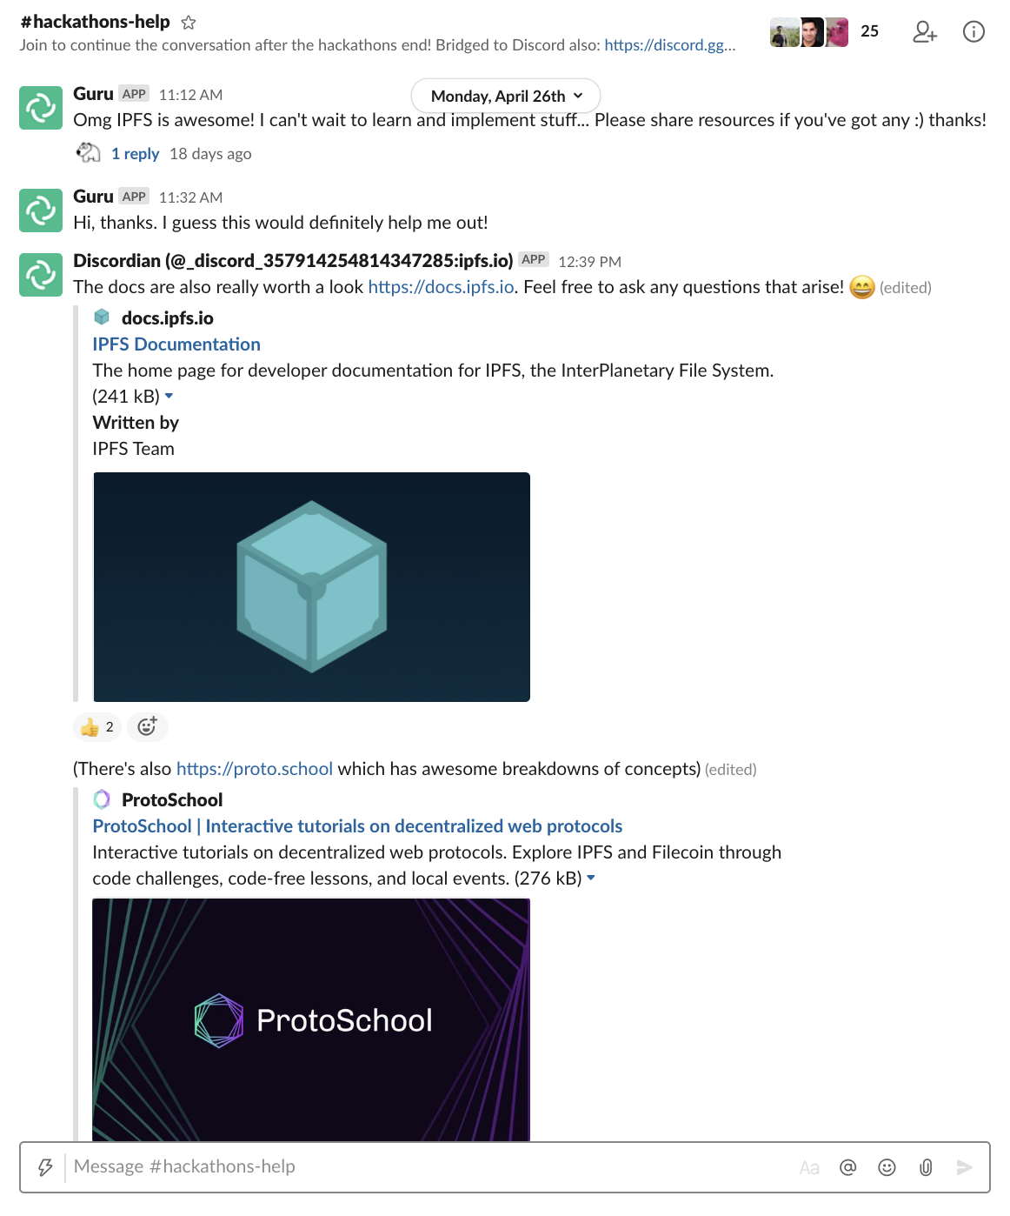
Reach out if you need anything
Ask in the 🛠️ #fil-builders 🛠️ channel in Filecoin Slack (filecoin.io/slack)
Microgrants $5,000 to support your independent projects using IPFS or Filecoin! (grants@filecoin.org)

